Slide 1
The New Era Of Computer Science
By Qayyum Muhammad & Ouazouz Sami

Slide 2
Table of Content
Developpement
Of the
3E
Introduction
Cybersecurity
1
3
5
2
4
6
The 3E
Quantum Computing
Conclusion

Slide 3
1. Introduction
What is the New Era of Computer Science ?

Slide 4
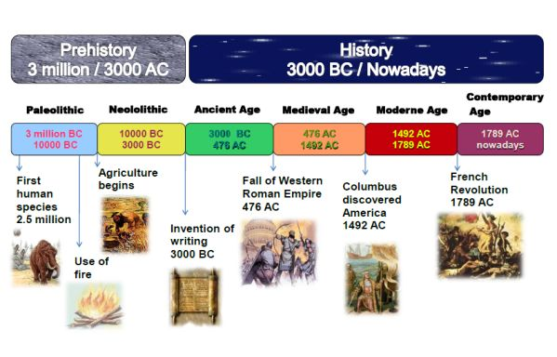
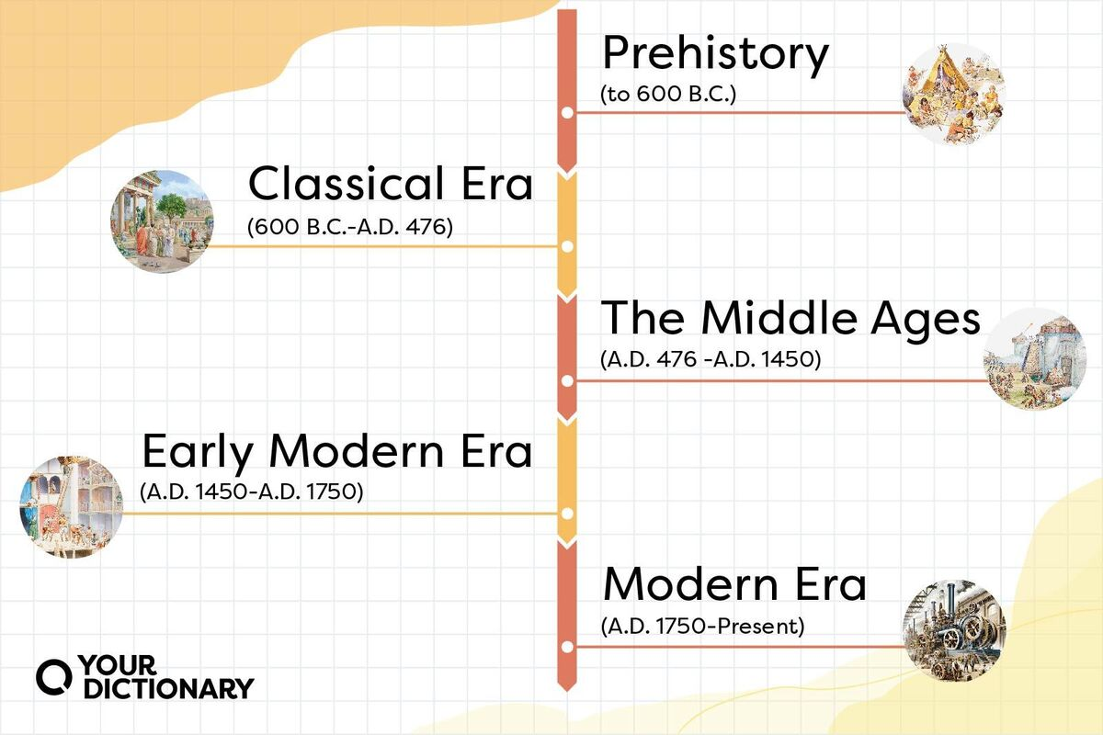
Different
Timelines

Slide 5

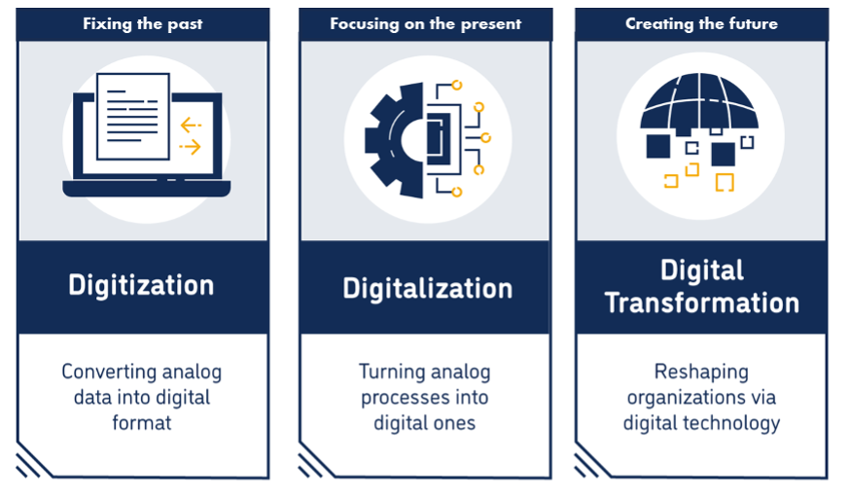
The Neospheric period
/The Cognitive era

Slide 6
2. The 3E
A concept describe the new evolution

Slide 7
Triple expansions
The 3E
Social
Education
Economic

Slide 8
3. Explications of the 3E
A little explication of every expansion

Slide 9
The social expansion
Social media:
Their omnipresence in our lives.
Online Communities:
Their presence online.

Slide 10
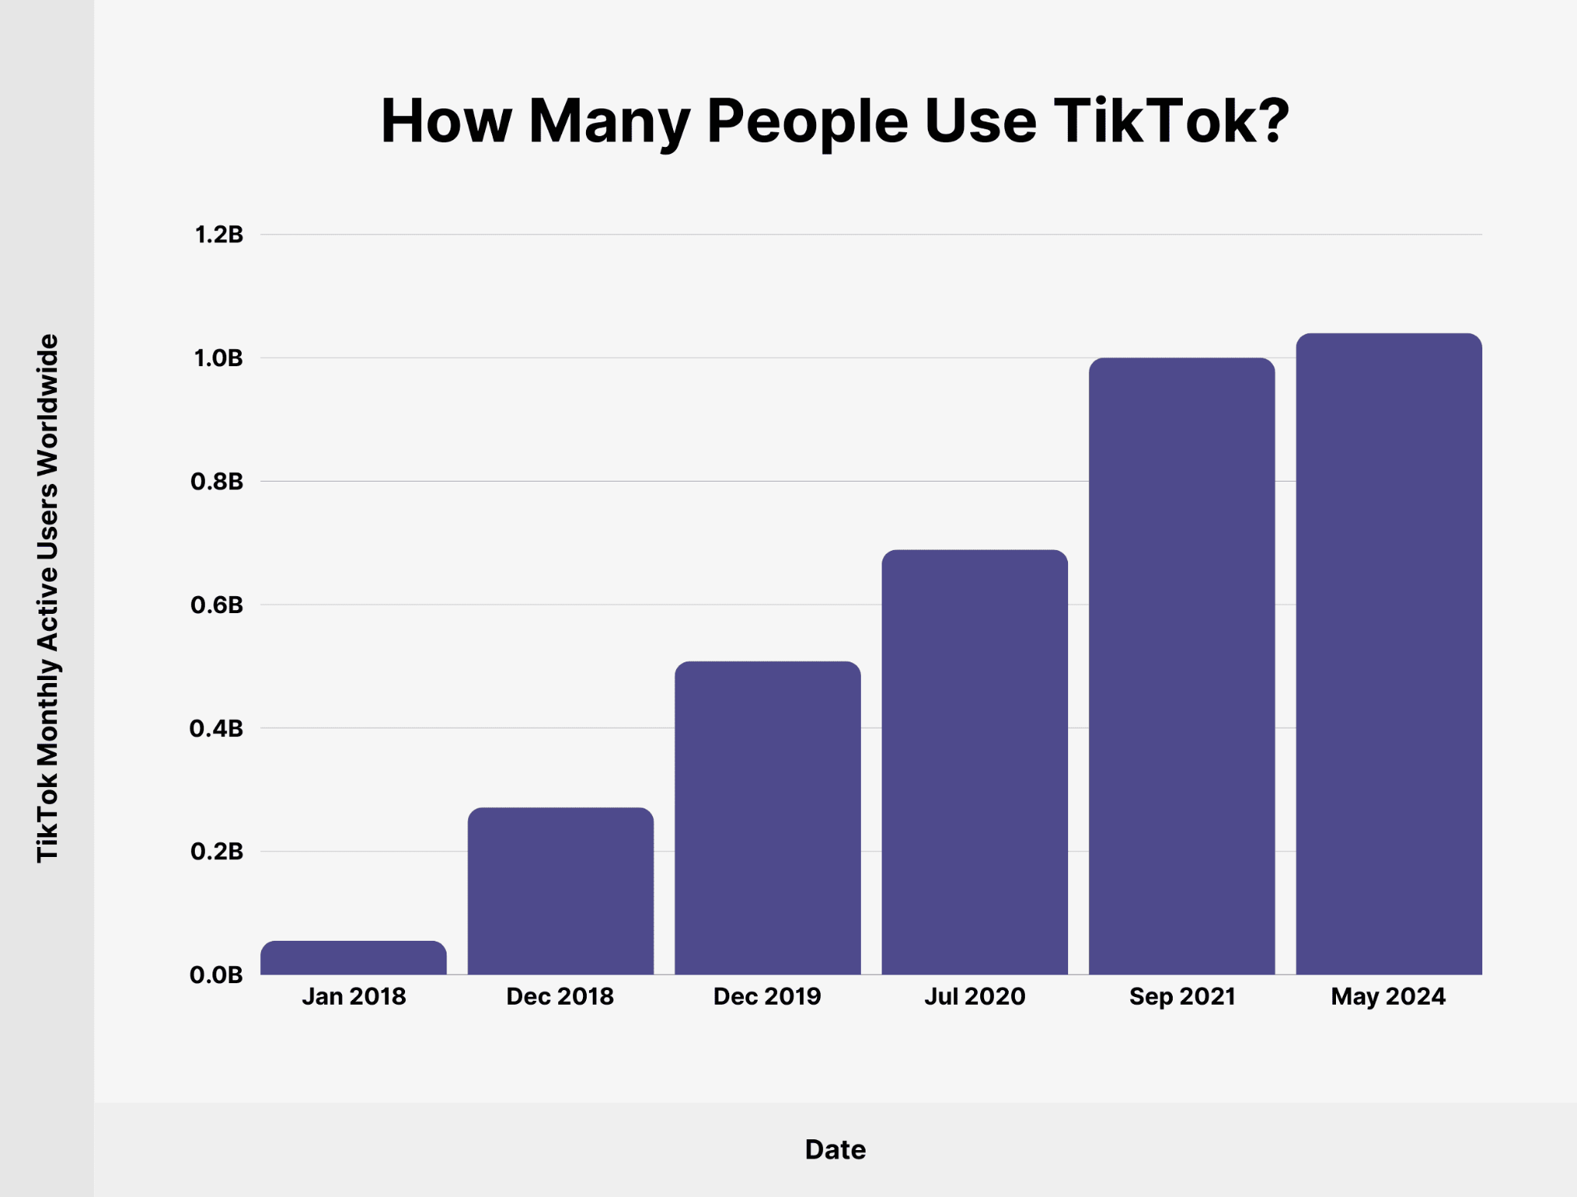

Social media

Slide 11
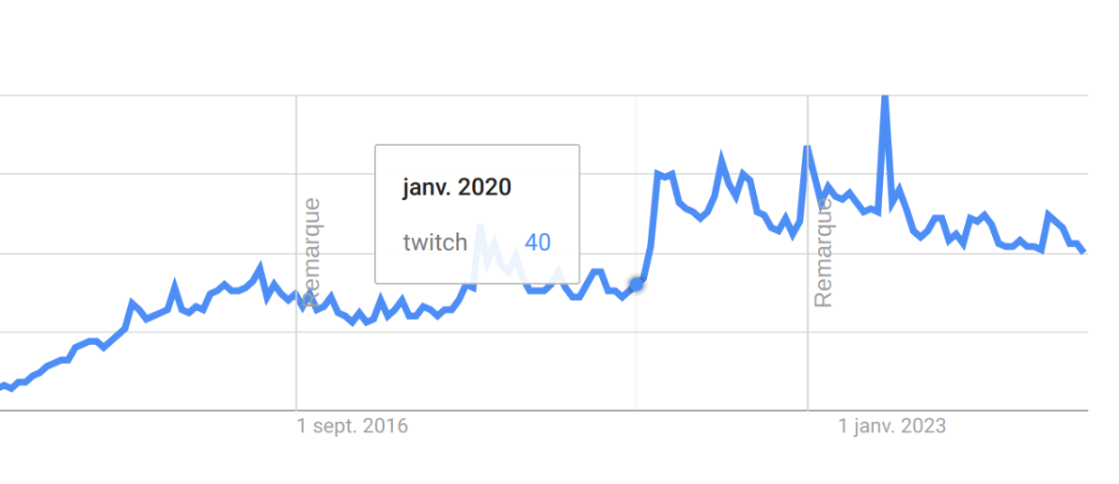
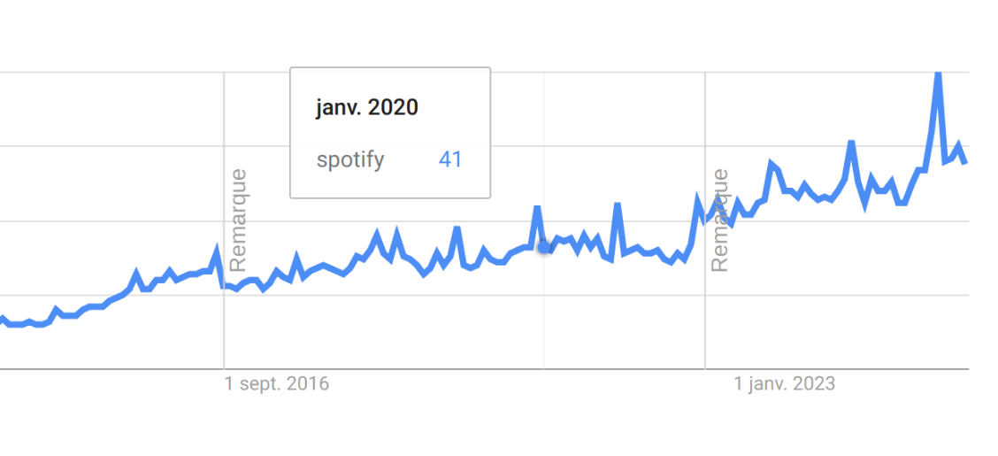
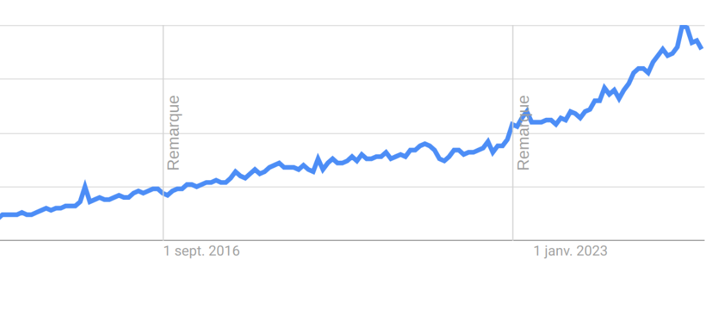
Online communities
Twitch
Spotify
Reddit

Slide 12



Online events

Slide 13
The Educational expansion
The use of online support and online learning

Slide 14
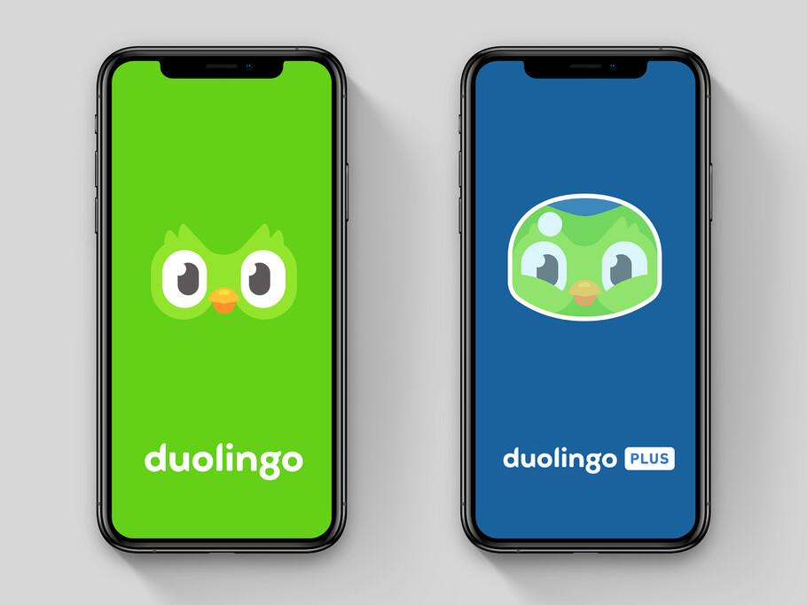
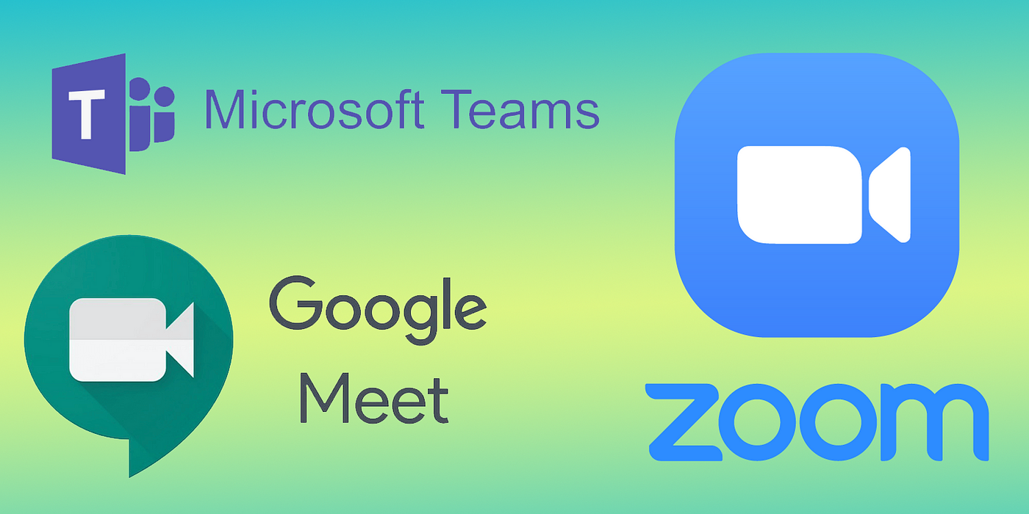
Online courses & learning

Slide 15
Economical Expansion
New type of money, investments, jobs, …

Slide 16

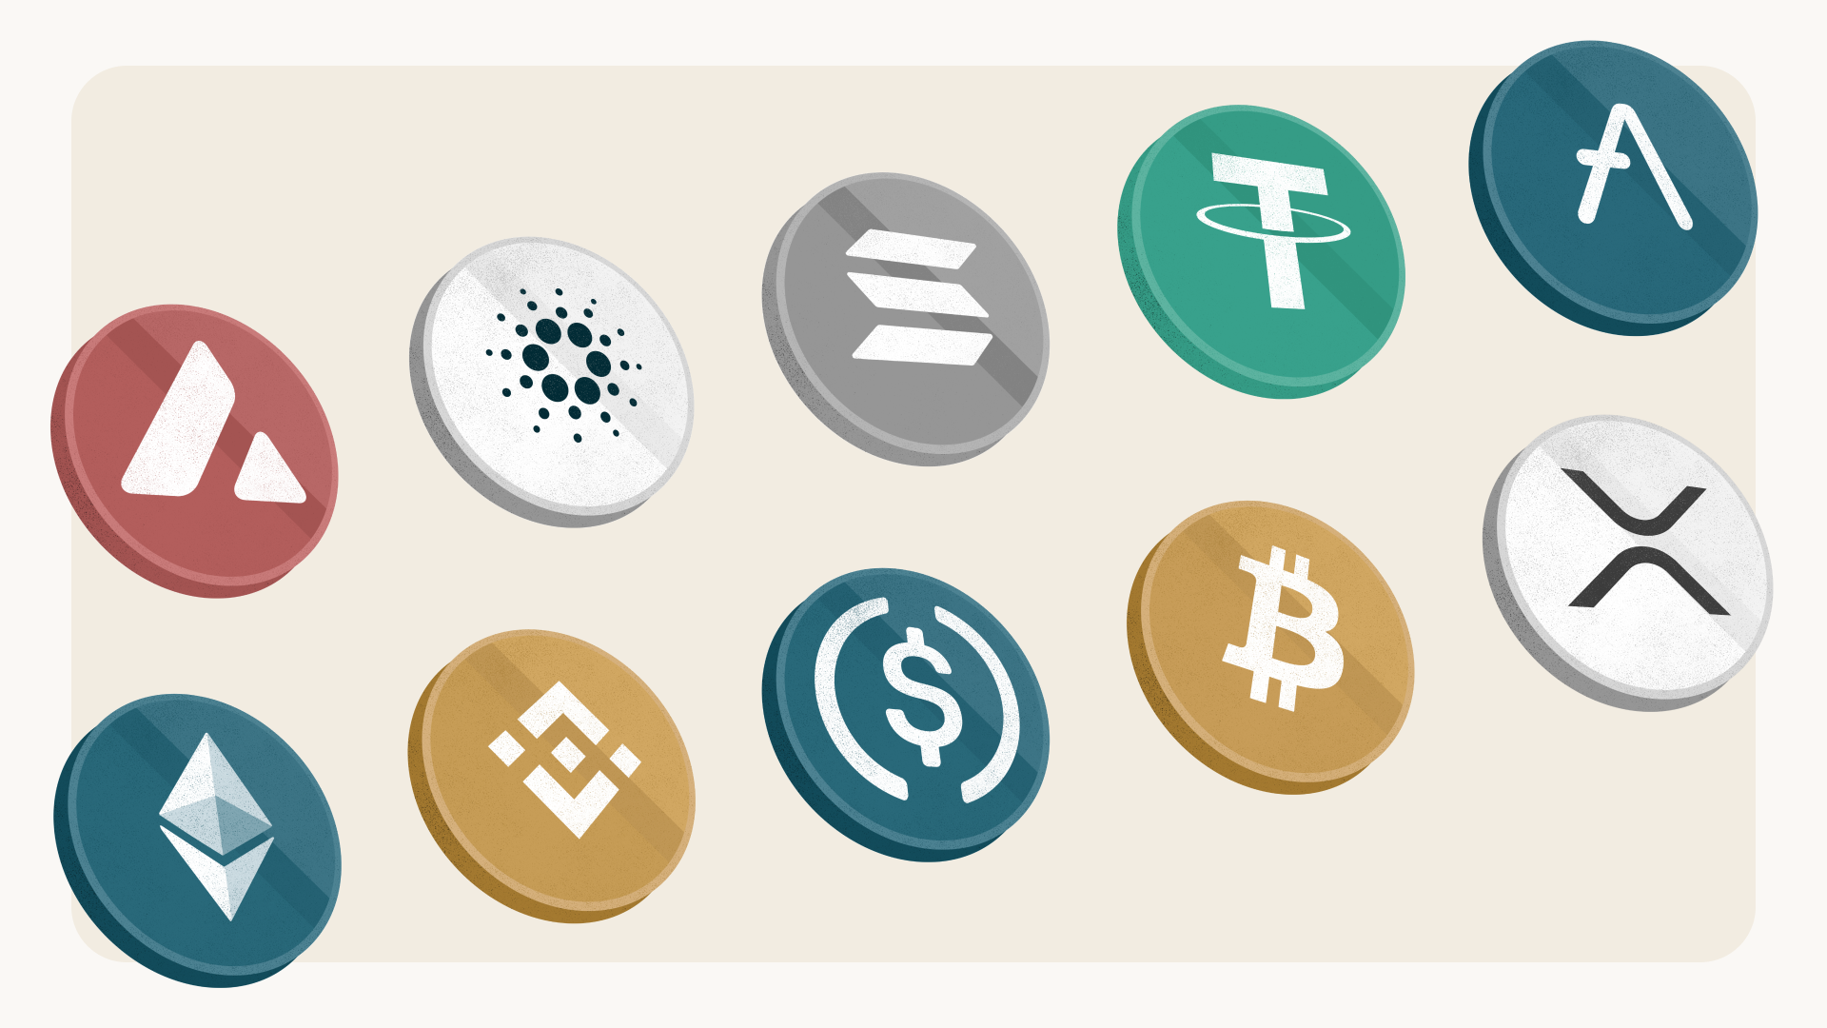
E-Economy

Slide 17
4. Quantum Computing
One of the cornerstones of the Neospheric Period

Slide 18
Quantum Computing
Binary Foundation
Traditional computers use bits
(0 or 1).
Strengths
Solutions to many complex problems.
B
S
Still in early stages, but growing fast.
Evolution
Cryptography breakdown & Global tech gap
THREATS
E
T

Slide 19
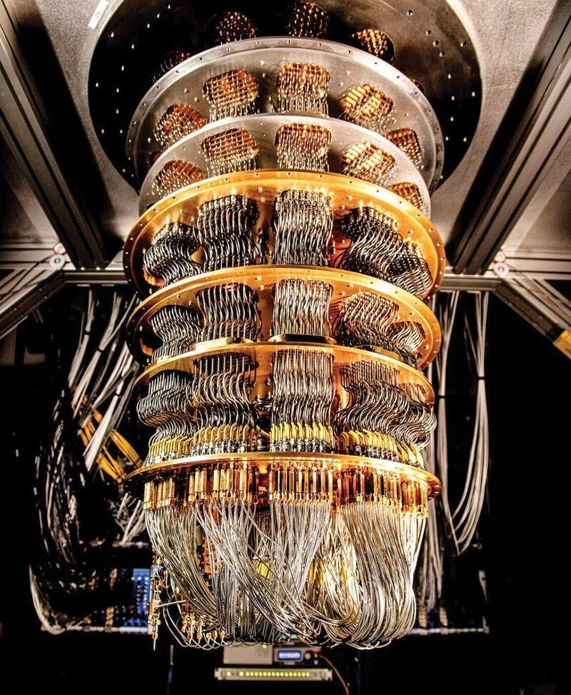
Google in 2019
Sycamore Processor
Normal execution time
Quantum execution time
Quantum supremacy
Complete a task that would be impossible.
A random quantum circuit
10,000 years
200 seconds.
1.5 billion times faster.

Slide 20
5. Cybersecurity & Privacy
Cybersecurity in the New Era

Slide 21
New Threats
Increasing Connectivity
Rise Of Threats
Global Response Needed
Data Privacy
Online Attacks
AI-Generated Phishing
High-Risk Sectors
Personal Data

Slide 22
6. Conclusion

Slide 23
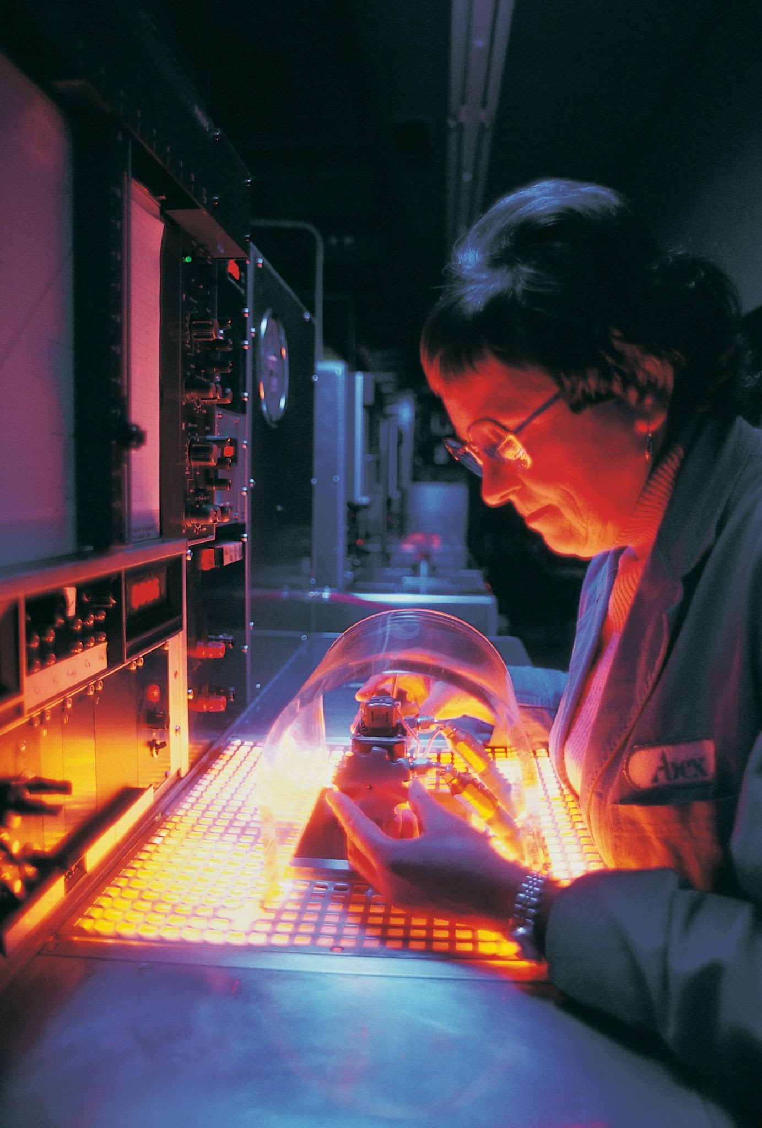
Evolution
New phase (3E)
More connected and more digitized than ever before
❌ "Are we changing?"
✅"How fast are we willing to adapt?

Slide 24
Bibliography
https://www.ibm.com/think/topics/quantum-computing
https://www.planetcompliance.com/it-compliance/what-is-the-importance-of-cybersecurity/
https://fieldeffect.com/blog/what-is-the-future-of-cyber-security
https://www.journaldugeek.com/2023/07/05/quantique-google-frappe-un-grand-coup-avec-son-processeur-sycamore/
https://www.ouest-france.fr/gaming/zevent-2024-statistiques-stars-presentes-le-resume-dun-marathon-caritatif-encore-exceptionnel-a1b179e0-6d30-11ef-ae01-eadd2e601b92

